Slide 1
Operations on a BST
Creating the BST
Inserting item
Retrieving (finding) item
Deleting item
Printing the BST

Slide 2
Binary Search Tree Specification
Structure: | The placement of each element in the binary tree must satisfy the binary search property: The value of the key of an element is greater than the value of the key of any element in its left subtree, and less than the value of the key of any element in its right subtree.
Operations:
MakeEmpty
Function | Initializes tree to empty state.
Postcondition | Tree exists and is empty.
Boolean IsEmpty
Function | Determines whether tree is empty.
Postcondition | Returns true if tree is empty and false otherwise.
Boolean IsFull
Function | Determines whether tree is full.
Postcondition | Returns true if tree is full and false otherwise.

Slide 3
Binary Search Tree Specification
int LengthIs
Function | Determines the number of elements in tree.
Postcondition | Returns the number of elements in tree.
RetrieveItem(ItemType& item. Boolean& found)
Function | Retrieves item whose key matches item's key (if present).
Precondition | Key member of item is initialized.
Postcondition | If there is an element someItem whose key matches item's key, then found = true and item is a copy of someItem; otherwise, found = false and item is unchanged. Tree is unchanged.
InsertItem(ItemType item)
Function | Adds item to tree.
Precondition | Tree is not full. item is not in tree.
Postcondition | item is in tree. Binary search property is maintained.

Slide 4
Binary Search Tree Specification
DeleteItem(ItemType item)
Function | Deletes the element whose key matches item's key.
Precondition | Key member of item is initialized. One and only one element in tree has a key matching item's key.
Postcondition | No element in tree has a key matching item's key.
Print()
Function | Prints the values in the tree in ascending key order.
Postcondition | Items in the tree are printed in ascending key order.

Slide 5
Binary Search Tree Specification
ResetTree(OrderType order)
Function | Initializes current position for an iteration through the tree in OrderType order.
Postcondition | Current position is prior to root of tree.
GetNextItem(ItemType& item, OrderType order, Boolean& finished)
Function | Gets the next element in tree.
Precondition | Current position is defined. Element at current position is not last in tree.
Postcondition | Current position is one position beyond current position at entry to GetNextItem. finished = (current position is last in tree). item is a copy of element at current position.

Slide 6
Implementing the Nodes in Binary Search Tree
left
info
right
struct TreeNode
{
ItemType info;
TreeNode *left;
TreeNode *right;
};

Slide 7
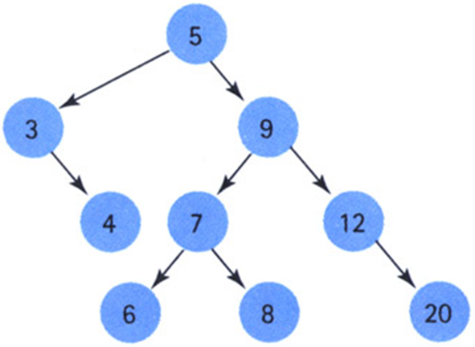
Implementing the Nodes in Binary Search Tree
left
info
right
struct TreeNode
{
ItemType info;
TreeNode *left;
TreeNode *right;
};
TreeNode *root
5
3
9
4
7
12
6
8
20

Slide 8
binarysearchtree.h
#ifndef BINARYSEARCHTREE_H_INCLUDED
#define BINARYSEARCHTREE_H_INCLUDED
typedef char ItemType;
struct TreeNode{ItemType info;TreeNode *left, *right;};
enum OrderType {PRE_ORDER, IN_ORDER, POST_ORDER};
class TreeType
{
public:
TreeType();
~TreeType();
void MakeEmpty();
bool IsEmpty();
bool IsFull();
int LengthIs();
void RetrieveItem(ItemType& item, bool& found);
void InsertItem(ItemType item);
void DeleteItem(ItemType item);
void ResetTree(OrderType order);
void GetNextItem(ItemType& item, OrderType order, bool& finished);
void Print();
private:
TreeNode* root;
};
#endif // BINARYSEARCHTREE_H_INCLUDED

Slide 9
binarysearchtree.cpp
#include "binarysearchtree.h"
#include <new>
TreeType::TreeType()
{
root = NULL;
}
bool TreeType::IsEmpty()
{
return root == NULL;
}
bool TreeType::IsFull()
{
TreeNode* location;
try
{
location = new TreeNode;
delete location;
return false;
}
catch(std::bad_alloc exception)
{
return true;
}
}

Slide 10
binarysearchtree.cpp
#include "binarysearchtree.h"
#include <new>
TreeType::TreeType()
{
root = NULL;
}
bool TreeType::IsEmpty()
{
return root == NULL;
}
bool TreeType::IsFull()
{
TreeNode* location;
try
{
location = new TreeNode;
delete location;
return false;
}
catch(std::bad_alloc exception)
{
return true;
}
}
O(1)
O(1)
O(1)

Slide 11
Function InsertItem
TreeNode *root

Slide 12
Function InsertItem
Insert 5
TreeNode *root

Slide 13
Function InsertItem
Insert 5
TreeNode *root
5

Slide 14
Function InsertItem
Insert 9
TreeNode *root
5

Slide 15
Function InsertItem
Insert 9
TreeNode *root
5
9

Slide 16
Function InsertItem
Insert 7
TreeNode *root
5
9

Slide 17
Function InsertItem
Insert 7
TreeNode *root
5
9
7

Slide 18
Function InsertItem
Insert 3
TreeNode *root
5
9
7

Slide 19
Function InsertItem
Insert 3
TreeNode *root
5
3
9
7

Slide 20
Function InsertItem
Insert 8
TreeNode *root
5
3
9
7

Slide 21
Function InsertItem
Insert 8
TreeNode *root
5
3
9
7
8

Slide 22
Function InsertItem
Insert 12
TreeNode *root
5
3
9
7
8

Slide 23
Function InsertItem
Insert 12
TreeNode *root
5
3
9
7
12
8

Slide 24
Function InsertItem
Insert 6
TreeNode *root
5
3
9
7
12
8

Slide 25
Function InsertItem
Insert 6
TreeNode *root
5
3
9
7
12
6
8

Slide 26
Function InsertItem
Insert 4
TreeNode *root
5
3
9
7
12
6
8

Slide 27
Function InsertItem
Insert 4
TreeNode *root
5
3
9
4
7
12
6
8

Slide 28
Function InsertItem
Insert 20
TreeNode *root
5
3
9
4
7
12
6
8

Slide 29
Function InsertItem
Insert 20
TreeNode *root
5
3
9
4
7
12
6
8
20

Slide 30
Function InsertItem
void Insert(TreeNode *&tree, ItemType item)
{
if (tree == NULL)//Base case:Insertion place found.
{
tree = new TreeNode;
tree->right = NULL;
tree->left = NULL:
tree->info = item;
}
else if (item < tree->info)
Insert(tree->left, item);//General case 1:Insert in left subtree.
else
Insert(tree->right, item);//General case 2:Insert in right subtree.
}
void TreeType::InsertItem(ItemType item)
{
Insert(root, item):
}

Slide 31
Function InsertItem
root

Slide 32
Function InsertItem
InsertItem(5)
root

Slide 33
Function InsertItem
InsertItem(5)
root
Insert(root,5)

Slide 34
Function InsertItem
InsertItem(5)
root
Insert(root,5)
Base case

Slide 35
Function InsertItem
InsertItem(5)
root
Insert(root,5)
Base case
5

Slide 36
Function InsertItem
InsertItem(5)
root
5

Slide 37
Function InsertItem
root
5

Slide 38
Function InsertItem
InsertItem(9)
root
5

Slide 39
Function InsertItem
InsertItem(9)
root
Insert(root,9)
5

Slide 40
Function InsertItem
InsertItem(9)
root
Insert(root,9)
General case 2
5

Slide 41
Function InsertItem
InsertItem(9)
root
Insert(root,9)
General case 2
5
Insert(root->right,9)

Slide 42
Function InsertItem
InsertItem(9)
root
Insert(root,9)
General case 2
5
Insert(root->right,9)
Base case

Slide 43
Function InsertItem
InsertItem(9)
root
Insert(root,9)
General case 2
5
Insert(root->right,9)
Base case
9

Slide 44
Function InsertItem
InsertItem(9)
root
Insert(root,9)
General case 2
5
9

Slide 45
Function InsertItem
InsertItem(9)
root
5
9

Slide 46
Function InsertItem
root
5
9

Slide 47
Function InsertItem
InsertItem(7)
root
5
9

Slide 48
Function InsertItem
InsertItem(7)
root
Insert(root,7)
5
9

Slide 49
Function InsertItem
InsertItem(7)
root
Insert(root,7)
General case 2
5
9

Slide 50
Function InsertItem
InsertItem(7)
root
Insert(root,7)
General case 2
5
Insert(root->right,7)
9

Slide 51
Function InsertItem
InsertItem(7)
root
Insert(root,7)
General case 2
5
Insert(root->right,7)
General case 1
9

Slide 52
Function InsertItem
InsertItem(7)
root
Insert(root,7)
General case 2
5
Insert(root->right,7)
General case 1
9
Insert(root->right->left,7)

Slide 53
Function InsertItem
InsertItem(7)
root
Insert(root,7)
General case 2
5
Insert(root->right,7)
General case 1
9
Insert(root->right->left,7)
Base case

Slide 54
Function InsertItem
InsertItem(7)
root
Insert(root,7)
General case 2
5
Insert(root->right,7)
General case 1
9
Insert(root->right->left,7)
Base case
7

Slide 55
Function InsertItem
InsertItem(7)
root
Insert(root,7)
General case 2
5
Insert(root->right,7)
General case 1
9
7

Slide 56
Function InsertItem
InsertItem(7)
root
Insert(root,7)
General case 2
5
9
7

Slide 57
Function InsertItem
InsertItem(7)
root
5
9
7

Slide 58
Function InsertItem
root
5
9
7

Slide 59
Function InsertItem
InsertItem(3)
root
5
9
7

Slide 60
Function InsertItem
InsertItem(3)
root
Insert(root,3)
5
9
7

Slide 61
Function InsertItem
InsertItem(3)
root
Insert(root,3)
General case 1
5
9
7

Slide 62
Function InsertItem
InsertItem(3)
root
Insert(root,3)
General case 1
5
Insert(root->left,3)
9
7

Slide 63
Function InsertItem
InsertItem(3)
root
Insert(root,3)
General case 1
5
Insert(root->left,3)
Base case
9
7

Slide 64
Function InsertItem
InsertItem(3)
root
Insert(root,3)
General case 1
5
Insert(root->left,3)
Base case
3
9
7

Slide 65
Function InsertItem
InsertItem(3)
root
Insert(root,3)
General case 1
5
3
9
7

Slide 66
Function InsertItem
InsertItem(3)
root
5
3
9
7

Slide 67
Function InsertItem
root
5
3
9
7

Slide 68
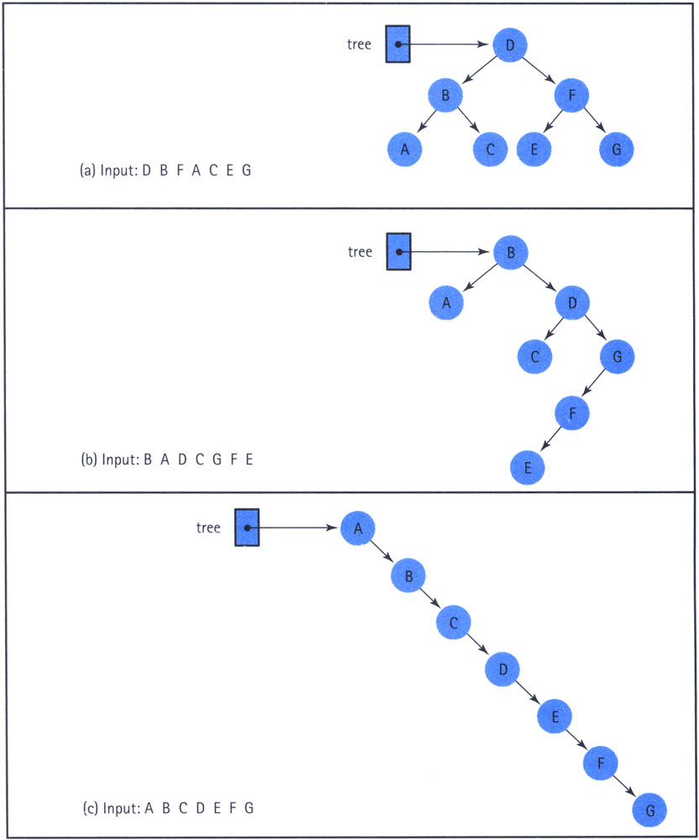
Function InsertItem
Impact of order of insertion on tree height

Slide 69
Function InsertItem
Impact of order of insertion on tree height

Slide 70
Function InsertItem
Impact of order of insertion on tree height

Slide 71
Function InsertItem
void Insert(TreeNode *&tree, ItemType item)
{
if (tree == NULL)//Base case:Insertion place found.
{
tree = new TreeNode;
tree->right = NULL;
tree->left = NULL:
tree->info = item;
}
else if (item < tree->info)
Insert(tree->left, item);//General case 1:Insert in left subtree.
else
Insert(tree->right, item);//General case 2:Insert in right subtree.
}
void TreeType::InsertItem(ItemType item)
{
Insert(root, item):
}
Worst case: O(N)
Best case: O(logN)

Slide 72
Function LengthIs
Calculate the number of nodes in the tree recursively
If tree is empty (base case)
length = 0
If tree is non-empty (general case)
Length = number of nodes in the left subtree + number of nodes in the right subtree + 1
Number of nodes in left subtree + 1 + Number of nodes in right subtree

Slide 73
Function LengthIs
int CountNodes(TreeNode* tree)
{
if (tree == NULL)
return 0;
else
return CountNodes(tree->left) + CountNodes(tree->right) + 1;
}
int TreeType::LengthIs()
{
return CountNodes(root);
}

Slide 74
Function LengthIs
root
5
3
9
4
7
12
6
8
20

Slide 75
Function LengthIs
root
5
3
9
4
7
12
6
8
20

Slide 76
Function LengthIs
root
5
3
9
4
7
12
6
8
20

Slide 77
Function LengthIs
root
5
3
9
4
7
12
6
8
20

Slide 78
Function LengthIs
root
5
3
9
0
4
7
12
6
8
20

Slide 79
Function LengthIs
root
5
3
9
0
4
7
12
6
8
20

Slide 80
Function LengthIs
root
5
3
9
0
4
7
12
6
8
20

Slide 81
Function LengthIs
root
5
3
9
0
4
7
12
0
6
8
20

Slide 82
Function LengthIs
root
5
3
9
0
4
7
12
0
6
8
20

Slide 83
Function LengthIs
root
5
3
9
0
4
7
12
0
0
6
8
20

Slide 84
Function LengthIs
root
5
3
9
0
1
4
7
12
0
0
6
8
20

Slide 85
Function LengthIs
root
5
3
9
0
1
4
7
12
0
0
6
8
20

Slide 86
Function LengthIs
root
5
2
3
9
0
1
4
7
12
0
0
6
8
20

Slide 87
Function LengthIs
root
5
2
3
9
0
1
4
7
12
0
0
6
8
20

Slide 88
Function LengthIs
root
5
2
3
9
0
1
4
7
12
0
0
6
8
20

Slide 89
Function LengthIs
root
5
2
3
9
0
1
4
7
12
0
0
6
8
20

Slide 90
Function LengthIs
root
5
2
3
9
0
1
4
7
12
0
0
6
8
20

Slide 91
Function LengthIs
root
5
2
3
9
0
1
4
7
12
0
0
6
8
20
0

Slide 92
Function LengthIs
root
5
2
3
9
0
1
4
7
12
0
0
6
8
20
0

Slide 93
Function LengthIs
root
5
2
3
9
0
1
4
7
12
0
0
6
8
20
0
0

Slide 94
Function LengthIs
root
5
2
3
9
0
1
4
7
12
0
0
6
8
20
0
0

Slide 95
Function LengthIs
root
5
2
3
9
0
1
4
7
12
0
0
1
6
8
20
0
0

Slide 96
Function LengthIs
root
5
2
3
9
0
1
4
7
12
0
0
1
6
8
20
0
0

Slide 97
Function LengthIs
root
5
2
3
9
0
1
4
7
12
0
0
1
6
8
20
0
0

Slide 98
Function LengthIs
root
5
2
3
9
0
1
4
7
12
0
0
1
6
8
20
0
0
0

Slide 99
Function LengthIs
root
5
2
3
9
0
1
4
7
12
0
0
1
6
8
20
0
0
0

Slide 100
Function LengthIs
root
5
2
3
9
0
1
4
7
12
0
0
1
6
8
20
0
0
0
0

Slide 101
Function LengthIs
root
5
2
3
9
0
1
4
7
12
0
0
1
6
8
20
0
0
0
0

Slide 102
Function LengthIs
root
5
2
3
9
0
1
4
7
12
0
0
1
1
6
8
20
0
0
0
0

Slide 103
Function LengthIs
root
5
2
3
9
0
1
4
7
12
0
0
1
1
6
8
20
0
0
0
0

Slide 104
Function LengthIs
root
5
2
3
9
0
1
3
4
7
12
0
0
1
1
6
8
20
0
0
0
0

Slide 105
Function LengthIs
root
5
2
3
9
0
1
3
4
7
12
0
0
1
1
6
8
20
0
0
0
0

Slide 106
Function LengthIs
root
5
2
3
9
0
1
3
4
7
12
0
0
1
1
6
8
20
0
0
0
0

Slide 107
Function LengthIs
root
5
2
3
9
0
1
3
4
7
12
0
0
1
1
0
6
8
20
0
0
0
0

Slide 108
Function LengthIs
root
5
2
3
9
0
1
3
4
7
12
0
0
1
1
0
6
8
20
0
0
0
0

Slide 109
Function LengthIs
root
5
2
3
9
0
1
3
4
7
12
0
0
1
1
0
6
8
20
0
0
0
0

Slide 110
Function LengthIs
root
5
2
3
9
0
1
3
4
7
12
0
0
1
1
0
6
8
20
0
0
0
0
0

Slide 111
Function LengthIs
root
5
2
3
9
0
1
3
4
7
12
0
0
1
1
0
6
8
20
0
0
0
0
0

Slide 112
Function LengthIs
root
5
2
3
9
0
1
3
4
7
12
0
0
1
1
0
6
8
20
0
0
0
0
0
0

Slide 113
Function LengthIs
root
5
2
3
9
0
1
3
4
7
12
0
0
1
1
0
6
8
20
0
0
0
0
0
0

Slide 114
Function LengthIs
root
5
2
3
9
0
1
3
4
7
12
0
0
1
1
0
1
6
8
20
0
0
0
0
0
0

Slide 115
Function LengthIs
root
5
2
3
9
0
1
3
4
7
12
0
0
1
1
0
1
6
8
20
0
0
0
0
0
0

Slide 116
Function LengthIs
root
5
2
3
9
0
1
3
2
4
7
12
0
0
1
1
0
1
6
8
20
0
0
0
0
0
0

Slide 117
Function LengthIs
root
5
2
3
9
0
1
3
2
4
7
12
0
0
1
1
0
1
6
8
20
0
0
0
0
0
0

Slide 118
Function LengthIs
root
5
2
6
3
9
0
1
3
2
4
7
12
0
0
1
1
0
1
6
8
20
0
0
0
0
0
0

Slide 119
Function LengthIs
root
5
2
6
3
9
0
1
3
2
4
7
12
0
0
1
1
0
1
6
8
20
0
0
0
0
0
0

Slide 120
Function LengthIs
9
root
5
2
6
3
9
0
1
3
2
4
7
12
0
0
1
1
0
1
6
8
20
0
0
0
0
0
0

Slide 121
Function LengthIs
int CountNodes(TreeNode* tree)
{
if (tree == NULL)
return 0;
else
return CountNodes(tree->left) + CountNodes(tree->right) + 1;
}
int TreeType::LengthIs()
{
return CountNodes(root);
}
O(N)

Slide 122
Function RetrieveItem
Find the target node recursively
If tree is empty (base case 1)
Item is not found in the tree
Item == current_node_info (base case 2)
Item is found
Item < current_node_info (general case 1)
Search the left subtree
Item > current_node_info (general case 2)
Search the right subtree

Slide 123
Function RetrieveItem
void Retrieve(TreeNode* tree, ItemType& item, bool& found)
{
if (tree == NULL)
found = false;
else if (item < tree->info)
Retrieve(tree->left, item, found);
else if (item > tree->info)
Retrieve(tree->right, item, found);
else
{
item = tree->info;
found = true;
}
}
void TreeType::RetrieveItem(ItemType& item, bool& found)
{
Retrieve(root, item, found);
}

Slide 124
Function RetrieveItem
Find 8
root
5
3
9
4
7
12
6
8
20

Slide 125
Function RetrieveItem
Find 8
root
5
3
9
4
7
12
6
8
20

Slide 126
Function RetrieveItem
Find 8
General case 2
root
5
3
9
4
7
12
6
8
20

Slide 127
Function RetrieveItem
Find 8
General case 2
root
5
3
9
4
7
12
6
8
20

Slide 128
Function RetrieveItem
Find 8
General case 2
root
General case 1
5
3
9
4
7
12
6
8
20

Slide 129
Function RetrieveItem
Find 8
General case 2
root
General case 1
5
3
9
4
7
12
6
8
20

Slide 130
Function RetrieveItem
Find 8
General case 2
root
General case 1
5
General case 2
3
9
4
7
12
6
8
20

Slide 131
Function RetrieveItem
Find 8
General case 2
root
General case 1
5
General case 2
3
9
4
7
12
6
8
20

Slide 132
Function RetrieveItem
Find 8
General case 2
root
General case 1
5
General case 2
3
9
Base case 2
4
7
12
6
8
20

Slide 133
Function RetrieveItem
root
5
3
9
4
7
12
6
8
20

Slide 134
Function RetrieveItem
Find 10
root
5
3
9
4
7
12
6
8
20

Slide 135
Function RetrieveItem
Find 10
root
5
3
9
4
7
12
6
8
20

Slide 136
Function RetrieveItem
Find 10
General case 2
root
5
3
9
4
7
12
6
8
20

Slide 137
Function RetrieveItem
Find 10
General case 2
root
5
3
9
4
7
12
6
8
20

Slide 138
Function RetrieveItem
Find 10
General case 2
root
General case 2
5
3
9
4
7
12
6
8
20

Slide 139
Function RetrieveItem
Find 10
General case 2
root
General case 2
5
3
9
4
7
12
6
8
20

Slide 140
Function RetrieveItem
Find 10
General case 2
root
General case 2
5
General case 1
3
9
4
7
12
6
8
20

Slide 141
Function RetrieveItem
Find 10
General case 2
root
General case 2
5
General case 1
3
9
4
7
12
6
8
20

Slide 142
Function RetrieveItem
Find 10
General case 2
root
General case 2
5
General case 1
3
9
Base case 1
4
7
12
6
8
20

Slide 143
Function RetrieveItem
void Retrieve(TreeNode* tree, ItemType& item, bool& found)
{
if (tree == NULL)
found = false;
else if (item < tree->info)
Retrieve(tree->left, item, found);
else if (item > tree->info)
Retrieve(tree->right, item, found);
else
{
item = tree->info;
found = true;
}
}
void TreeType::RetrieveItem(ItemType& item, bool& found)
{
Retrieve(root, item, found);
}
Worst case: O(N)
Best case: O(logN)

Slide 144
Function Print
Print the items in the tree (in sorted order) recursively
If tree is empty (base case)
Nothing to print
If tree is non-empty (general case)
Print the items in the left subtree
Print the item at the current node
Print the items in the right subtree

Slide 145
Function Print
void PrintTree(TreeNode* tree)
{
if (tree != NULL)
{
PrintTree(tree->left);
cout << tree->info << endl;
PrintTree(tree->right);
}
}
void TreeType::Print()
{
PrintTree(root);
}

Slide 146
Function Print
root
5
3
9
4
7
12
6
8
20

Slide 147
Function Print
root
5
3
9
4
7
12
6
8
20

Slide 148
Function Print
root
5
3
9
4
7
12
6
8
20

Slide 149
Function Print
root
5
3
9
4
7
12
6
8
20

Slide 150
Function Print
root
5
3
9
4
7
12
6
8
20
3

Slide 151
Function Print
root
5
3
9
4
7
12
6
8
20
3

Slide 152
Function Print
root
5
3
9
4
7
12
6
8
20
3

Slide 153
Function Print
root
5
3
9
4
7
12
6
8
20
3
4

Slide 154
Function Print
root
5
3
9
4
7
12
6
8
20
3
4

Slide 155
Function Print
root
5
3
9
4
7
12
6
8
20
3
4

Slide 156
Function Print
root
5
3
9
4
7
12
6
8
20
3
4

Slide 157
Function Print
root
5
3
9
4
7
12
6
8
20
3
4
5

Slide 158
Function Print
root
5
3
9
4
7
12
6
8
20
3
4
5

Slide 159
Function Print
root
5
3
9
4
7
12
6
8
20
3
4
5

Slide 160
Function Print
root
5
3
9
4
7
12
6
8
20
3
4
5

Slide 161
Function Print
root
5
3
9
4
7
12
6
8
20
3
4
5

Slide 162
Function Print
root
5
3
9
4
7
12
6
8
20
3
4
5
6

Slide 163
Function Print
root
5
3
9
4
7
12
6
8
20
3
4
5
6

Slide 164
Function Print
root
5
3
9
4
7
12
6
8
20
3
4
5
6

Slide 165
Function Print
root
5
3
9
4
7
12
6
8
20
3
4
5
6
7

Slide 166
Function Print
root
5
3
9
4
7
12
6
8
20
3
4
5
6
7

Slide 167
Function Print
root
5
3
9
4
7
12
6
8
20
3
4
5
6
7

Slide 168
Function Print
root
5
3
9
4
7
12
6
8
20
3
4
5
6
7
8

Slide 169
Function Print
root
5
3
9
4
7
12
6
8
20
3
4
5
6
7
8

Slide 170
Function Print
root
5
3
9
4
7
12
6
8
20
3
4
5
6
7
8

Slide 171
Function Print
root
5
3
9
4
7
12
6
8
20
3
4
5
6
7
8

Slide 172
Function Print
root
5
3
9
4
7
12
6
8
20
3
4
5
6
7
8
9

Slide 173
Function Print
root
5
3
9
4
7
12
6
8
20
3
4
5
6
7
8
9

Slide 174
Function Print
root
5
3
9
4
7
12
6
8
20
3
4
5
6
7
8
9

Slide 175
Function Print
root
5
3
9
4
7
12
6
8
20
3
4
5
6
7
8
9
12

Slide 176
Function Print
root
5
3
9
4
7
12
6
8
20
3
4
5
6
7
8
9
12

Slide 177
Function Print
root
5
3
9
4
7
12
6
8
20
3
4
5
6
7
8
9
12

Slide 178
Function Print
root
5
3
9
4
7
12
6
8
20
3
4
5
6
7
8
9
12
20

Slide 179
Function Print
root
5
3
9
4
7
12
6
8
20
3
4
5
6
7
8
9
12
20

Slide 180
Function Print
root
5
3
9
4
7
12
6
8
20
3
4
5
6
7
8
9
12
20

Slide 181
Function Print
root
5
3
9
4
7
12
6
8
20
3
4
5
6
7
8
9
12
20

Slide 182
Function Print
root
5
3
9
4
7
12
6
8
20
3
4
5
6
7
8
9
12
20

Slide 183
Function Print
root
5
3
9
4
7
12
6
8
20
3
4
5
6
7
8
9
12
20

Slide 184
Function Print
root
5
3
9
4
7
12
6
8
20
3
4
5
6
7
8
9
12
20

Slide 185
Function Print
void PrintTree(TreeNode* tree)
{
if (tree != NULL)
{
PrintTree(tree->left);
std::cout << tree->info << std::endl;
PrintTree(tree->right);
}
}
void TreeType::Print()
{
PrintTree(root);
}
O(N)

Slide 186
Deleting a Node
root
9
3
16
4
10
18
14
20
13
12

Slide 187
Deleting a Node
Deleting a leaf node (20).
root
9
3
16
4
10
18
14
20
13
12

Slide 188
Deleting a Node
Deleting a leaf node (20).
root
9
3
16
4
10
18
14
20
13
12

Slide 189
Deleting a Node
Deleting a node with one child (18).
root
9
3
16
4
10
18
14
20
13
12

Slide 190
Deleting a Node
Deleting a node with one child (18).
root
9
3
16
4
10
18
14
20
13
12

Slide 191
Deleting a Node
Deleting a node with two children (9).
root
9
3
16
4
10
18
14
20
13
12

Slide 192
Deleting a Node
Deleting a node with two children (9).
Replace it with its predecessor (rightmost nodes in the left subtree).
root
9
3
16
4
10
18
14
20
13
12

Slide 193
Deleting a Node
Deleting a node with two children (9).
Replace it with its predecessor (rightmost nodes in the left subtree).
root
4
3
16
4
10
18
14
20
13
12

Slide 194
Deleting a Node
Deleting a node with two children (16).
Replace it with its predecessor (rightmost nodes in the left subtree).
root
9
3
16
4
10
18
14
20
13
12

Slide 195
Deleting a Node
Deleting a node with two children (16).
Replace it with its predecessor (rightmost nodes in the left subtree).
root
9
3
14
4
10
18
14
20
13
12

Slide 196
Deleting a Node
Deleting a node with two children (16).
Replace it with its predecessor (rightmost nodes in the left subtree).
root
9
3
14
4
10
18
14
20
13
12

Slide 197
Function DeleteItem
void DeleteNode(TreeNode*& tree);
void subDelete(TreeNode*& tree, ItemType item);
void GetPredecessor(TreeNode* tree, ItemType& data);
void TreeType::DeleteItem(ItemType item)
{
Delete(root, item);
}
void Delete(TreeNode*& tree, ItemType item)
{
if (item < tree->info)
Delete(tree->left, item);
else if (item > tree->info)
Delete(tree->right, item);
else
DeleteNode(tree);
}

Slide 198
Function DeleteItem
void DeleteNode(TreeNode*& tree)
{
ItemType data;
TreeNode* tempPtr;
tempPtr = tree;
if (tree->left == NULL && tree->right == NULL)
{
tree = NULL;
delete tempPtr;
}
else if (tree->left == NULL)
{
tree = tree->right;
delete tempPtr;
}
else if (tree->right == NULL)
{
tree = tree->left;
delete tempPtr;
}
else
{
GetPredecessor(tree->left, data);
tree->info = data;
Delete(tree->left, data);
}
}

Slide 199
Function DeleteItem
void GetPredecessor(TreeNode* tree, ItemType& data)
{
while (tree->right != NULL)
tree = tree->right;
data = tree->info;
}

Slide 200
Traversal Techniques
root
9
3
16
4
10
18
Inorder
3 4 9 10 12 13 14 16 18 20
Postorder
4 3 12 13 14 10 20 18 16 9
Preorder
9 3 4 16 10 14 13 12 18 20
14
20
13
12

Slide 201
Traversing Binary Tree
Three ways of traversing the binary tree T with root R
Preorder
[a] Process the root R
[b] Traverse the left sub-tree of R in preorder
[c] Traverse the right sub-tree of R in preorder
a. k. a node-left-right traversal (NLR)

Slide 202
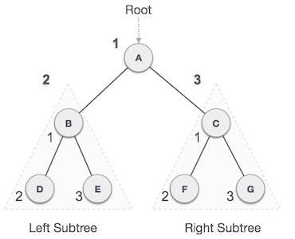
Pre-order Traversing
In this traversal method, the root node is visited first, then the left subtree and finally the right subtree.
Until all nodes are traversed −
Step 1 − Visit root node.
Step 2 − Recursively traverse left subtree.
Step 3 − Recursively traverse right subtree.
We start from A, and following pre-order traversal, we first visit A itself and then move to its left subtree B. B is also traversed pre-order. The process goes on until all the nodes are visited. The output of pre-order traversal of this tree will be −
A → B → D → E → C → F → G

Slide 203
Programming Code for preorder
void BinaryTree::printPreorder(BinaryTree *node)
{
if (node == NULL)
return;
cout << node->data << " ";
printPreorder(node->left);
printPreorder(node->right);
}
Until all nodes are traversed −
Step 1 − Visit root node.
Step 2 − Recursively traverse left subtree.
Step 3 − Recursively traverse right subtree.

Slide 204
Traversing Binary Tree
In-order
[a] Traverse the left sub-tree of R in inorder
[b] Process the root R
[c] Traverse the right sub-tree of R in in- order
a. k. a left-node-right traversal (LNR)

Slide 205
In-order Traversing
In this traversal method, the left subtree is visited first, then the root and later the right sub-tree. We should always remember that every node may represent a subtree itself.
If a binary tree is traversed in-order, the output will produce sorted key values in an ascending order.
Until all nodes are traversed −
Step 1 − Recursively traverse left subtree.
Step 2 − Visit root node.
Step 3 − Recursively traverse right subtree.
We start from A, and following in-order traversal, we move to its left subtree B. B is also traversed in-order. The process goes on until all the nodes are visited. The output of inorder traversal of this tree will be −
D → B → E → A→ F → C → G

Slide 206
Programming Code for inorder
void BinaryTree::printInorder(BinaryTree *node)
{
if (node == NULL)
return;
printInorder(node->left);
cout << node->data << " ";
printInorder(node->right);
}

Slide 207
Traversing Binary Tree
Post-order
[a] Traverse the left sub-tree of R in post-order
[b] Traverse the right sub-tree of R in postorder
[c] Process the root R
a. k. a left-right-node traversal (LRN)

Slide 208
Post-order Traversing
In this traversal method, the root node is visited last, hence the name. First we traverse the left subtree, then the right subtree and finally the root node.
Until all nodes are traversed −
Step 1 − Recursively traverse left subtree.
Step 2 − Recursively traverse right subtree.
Step 3 −Visit root node.
We start from A, and following Post-order traversal, we first visit the left subtree B. B is also traversed post-order. The process goes on until all the nodes are visited. The output of post-order traversal of this tree will be −
D → E → B → F → G → C → A

Slide 209
Programming Code for postorder
void BinaryTree::printPostorder(BinaryTree *node)
{
if (node == NULL)
return;
printPostorder(node->left);
printPostorder(node->right);
cout << node->data << " ";
}

Slide 210
Tree Traversal
There are basically three ways of binary tree traversals.
1. Inorder --- (left child,root,right child)
2. Preorder --- (root,left child,right child)
3. Postorder --- (left child,right child,root)

Slide 211
APPLICATIONS
1. Some applications of preorder traversal are the evaluation of expressions in prefix notation and the processing of abstract syntax trees by compilers.
2. Binary search trees (a special type of BT) use inorder traversal to print all of their data in alphanumeric order.
3. A popular application for the use of postorder traversal is the evaluating of expressions in postfix notation.

Slide 212
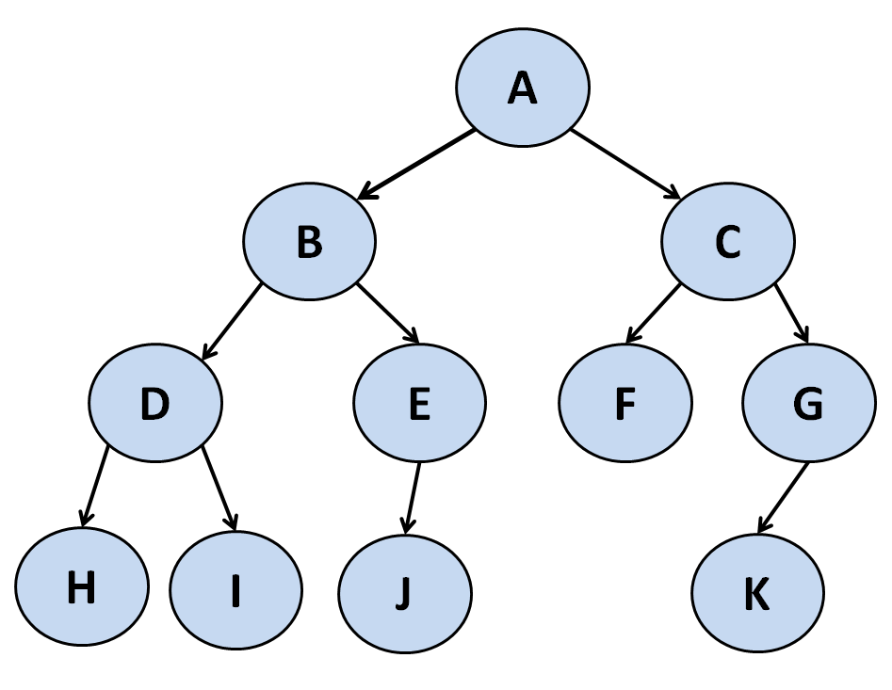
Illustrations for Traversals
Assume: visiting a node is printing its label
Preorder:A,
Inorder:
Postorder:

Slide 213
Illustrations for Traversals
Assume: visiting a node is printing its info
Preorder: A B D H I E J C F G K
Inorder: H D I B J E A F C K G
Postorder: H I D J E B F K G C A

Slide 214
Formulation of Binary tree from Its traversal
If preorder is given=>First node is the root
If postorder is given=>Last node is the root
Once the root node is identified, all nodes in the left subtrees and right subtrees of the root node can be identified.
Same technique can be applied repeatedly to form subtrees

Slide 215
4.Two traversals are essential out of which one should inorder, another may be preorder or postorder
5. But we can’t form a binary tree if only preorder
and postorder has given.
40

Slide 216
Example: For Given Inorder and Preorder
Inorder: D B H E A I F J CG
Preorder: A B D E H C F I J G
Now root is A
Left subtree: D B H E
Right subtree: I F J C G

Slide 217
continues.
A
In:D B H E Pre:B D E H
I F J C G C F I J G
D
H E
E H
I F J
F I J
G
I
J
H

Slide 218
Example: For Given Inorder and Postorder
Inorder: n1,n2, n3, n4, n5, n6, n7, n8, n9
Postorder: n1,n3, n5, n4, n2, n8, n7, n9, n6
So here n6 is the root

Slide 219
n6
In:n1,n2,n3,n4,n5
Post:n1,n3,n5,n4,n2
n7,n8,n9
n8,n7,n9
n1
n3,n4,n5
n7,n8
n3,n5,n4
n8,n7
n3
n5
n8

Slide 220
Inorder And Preorder
inorder = g d h b e i a f j c
preorder = a b d g h e i c f j
Scan the preorder left to right using the inorder to separate left and right subtrees.
a is the root of the tree; gdhbei are in the left subtree; fjc are in the right subtree.
a
gdhbei
fjc

Slide 221
Inorder And Preorder
a
gdhbei
fjc
preorder = a b d g h e i c f j
b is the next root; gdh are in the left subtree; ei are in the right subtree.
a
b
fjc
gdh
ei

Slide 222
Inorder And Preorder
a
b
fjc
gdh
ei
preorder = a b d g h e i c f j
d is the next root; g is in the left subtree; h is in the right subtree.
a
b
fjc
d
ei
g
h

Slide 223
Inorder And Postorder
Scan postorder from right to left using inorder to separate left and right subtrees.
inorder = g d h b e i a f j c
postorder = g h d i e b j f c a
Tree root is a; gdhbei are in left subtree; fjc are in right subtree.

